Slide 1

Are new monetary and fiscal policies required in the euro area?
Jérôme Creel
OFCE & ESCP Europe
Franco-German Conference, Paris, 7 July 2016

Slide 2
Outline
Secular stagnation, on the demand side
New monetary policy? Why?
  QE has begun
  Impact of QE on investment, not so low
  Impact of QE on stock prices, not so high, if any
New fiscal policy? Yes, please
  Fiscal leeway
  Adopting a golden rule of public finance

Slide 3
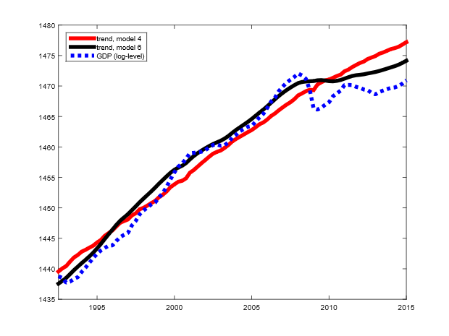
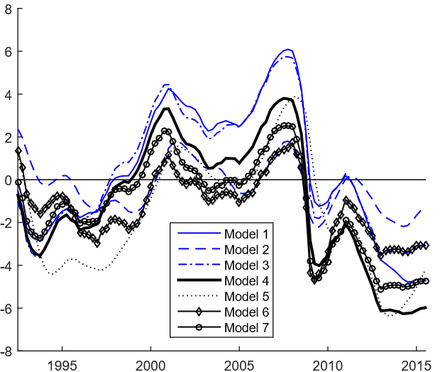
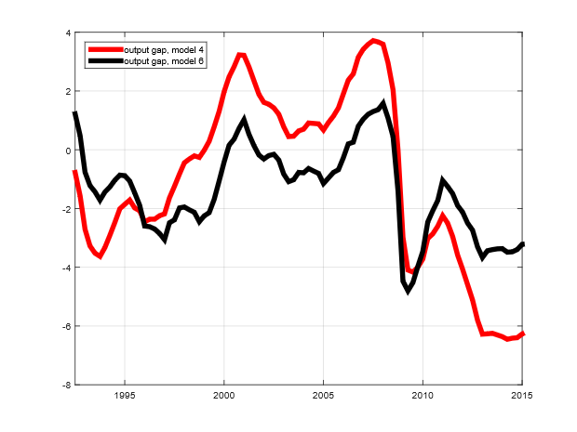
Shocking!
“(T)he results suggest that reconciling the secular stagnation hypothesis with the core inflation data is a challenge and may imply that policies aimed at stimulating demand should complement supply side policies in the economic policy mix.” (Jarocinski & Lenza, 2016, ECB WP)

Slide 4
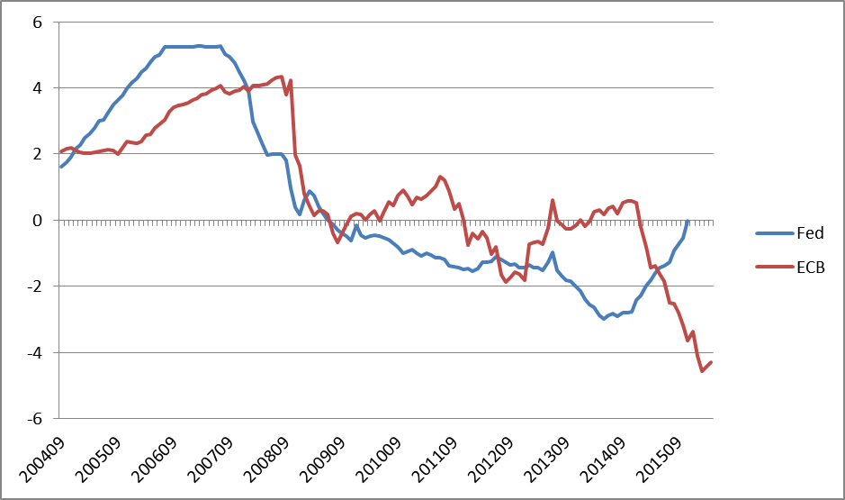
Monetary policy: what has happened?
ECB QE’s announcement
Source: Wu & Xia (JMCB, 2016)

Slide 5
Many risks associated with QE
Lack of liquidity for highly-demanded assets
Lack of safe assets (for collateral purposes)
Risks to financial stability
Excess volatility on emerging markets
Size of CB’s balance sheet makes it hard to reverse the monetary stance
CB independence & credibility undermined
Delayed fiscal consolidation
Distributional effects

Slide 6
Consensus on the macro effects in the US and UK
Source: Reza, Santor & Suchanek, Bk of Canada WP, 2015

Slide 7
Effects in the euro area before 2015
Drawing on conventional & unconventional measures before QE, Creel, Hubert & Viennot (AE, forthc.) show that
  the interest rate channel has worked in France, Germany, Italy & Spain
    The argument of the impairment of this channel to promote QE is misleading
  the effectiveness of unconventional measures depends on the instrument (EL, LTRO, SHMPP), the market (sovereign at different maturities, credit to NFC, housing) and the targeted variable (interest rate or new volumes)

Slide 10
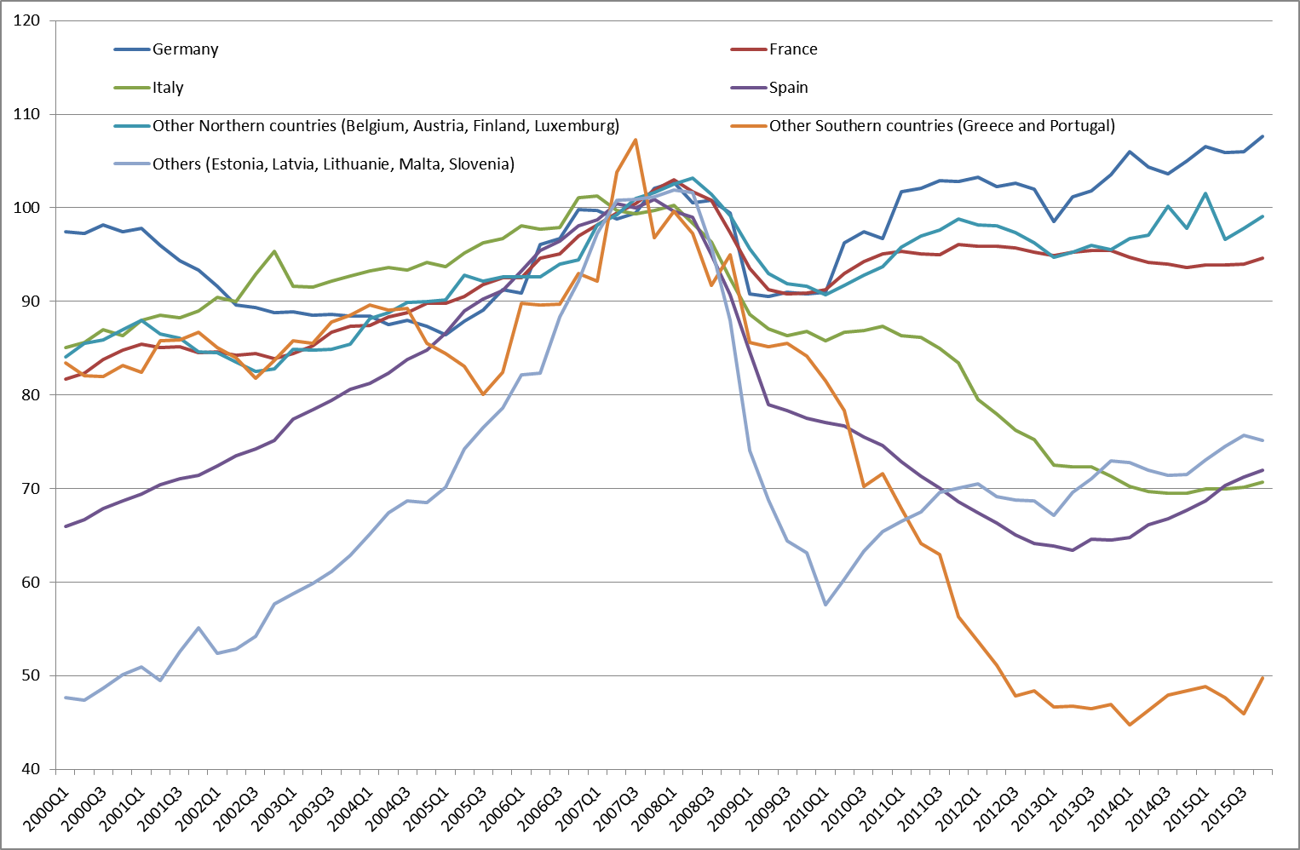
Effects in the euro area, including QE
A foreword: uneven investment paths in the euro area
Source: Eurostat

Slide 11
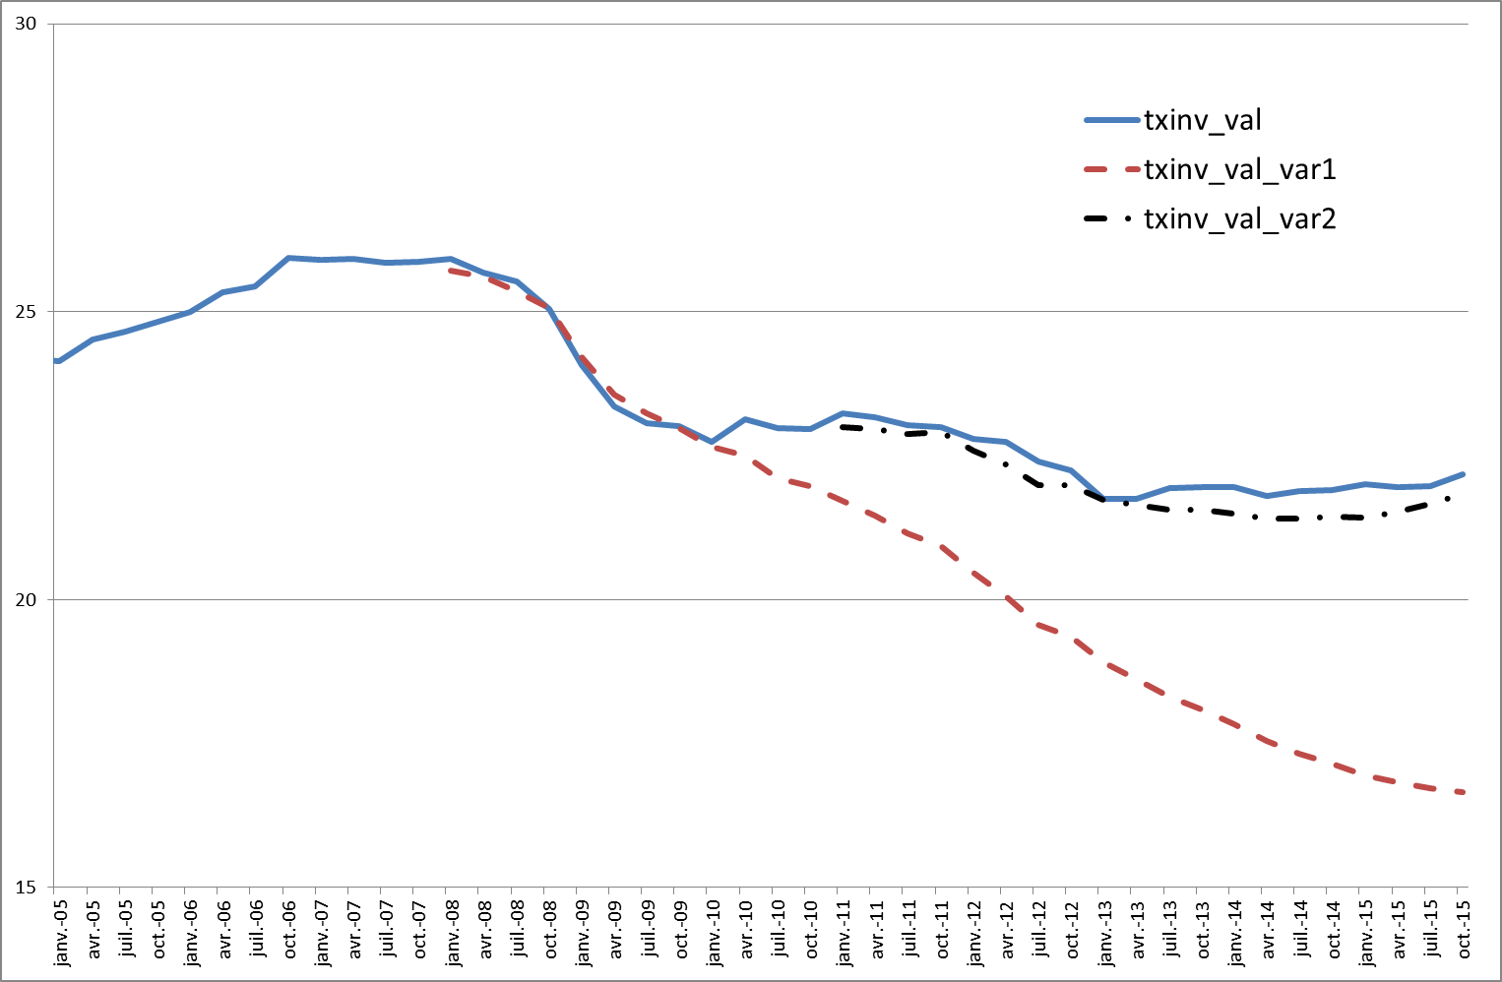
Effects in the euro area (c’nd)
Impact of ECB MP on investment (counterfactual)
Sample for estimation: 1999Q1/2015Q4.
Data sources: Eurostat, ECB & Datastream
without unconventional MP
without MP
Source: Blot, Creel, Hubert & Labondance, 2016, EP Monetary Dialogue

Slide 12
Effects in the euro area (c’nd)
ER
Stock prices
Data sample: Mar03 - Mar16
Source: Blot, Hubert & Rifflart (Revue de l’OFCE, 2016)
NB: with a large EA current account surplus, not surprising that UnConv-EUZ does not impinge on €/$ ER – neutral effect, at best, could be expected

Slide 13
Effects in the euro area (c’nd)
Distributional effects of MP
  Literature: inconclusive so far
    Doepke & Schneider (JPE, 2006) report that higher inflation reduces income inequality in the US (debtors vs. savers)
    Saiki & Frost (AE, 2014) report that unconventional MP increases income inequality in Japan (portfolio channel)
Using a VAR on euro area data, IRF of a restrictive MP shock gives:
VAR [UR, hours, IP, new credits, CPI, IR, CISS, €/$, Oil,2-y inf, 5-y inf, shadow rate], sep 04 – jan 15
Source: Blot, Creel, Hubert, Labondance & Ragot, 2015, EP Monetary Dialogue

Slide 14
Fiscal policy
It has been back!
Many questions, still
  On-going discussion about the value of fiscal multiplier over the cycle
    Barnichon & Matthes (CEPR WP, 2016): multiplier larger in recessions only because contractionary multiplier larger during recessions
  High deficits since GFC have produced large debts
    Crowding-out or crowding-in?
    Ricardian or non-Ricardian consumers?
  Should fiscal austerity continue?
  Should another set of fiscal rules be applied?

Slide 15
Dealing with austerity with iAGS model
iAGS for independent Annual Growth Survey
Reduced-form model
  Multi-country model (currently 11 EZ members)
  Interdependencies are captured by external (intra)trade and by common monetary policy
  Prices are represented by a Phillips curve
  A Taylor rule defines the stance of monetary policy
  Non-linear (time-varying) fiscal multiplier: high in recessions, low in booms
  Hysteresis effects

Slide 16
The costs of further consolidation
NB: remember the risks with QE. Here (with iAGS) delayed consolidation is better (lowest output gap)
Source: iAGS 2016

Slide 17
A golden rule of public finance?
Net public investment exempted from SGP rules and the Fiscal compact
The pros:
  economically sensible;
  fiscal leeway;
  end of sharp net investment decrease;
  potentially positive for potential output
The cons:
  crowding-out;
  incentivising tangible assets at the expense of intangible assets;
  creative accounting bias;
  debt increase

Slide 18
Net investment in the euro area
Sources: European Commission & Truger (IMK WP 2016)

Slide 19
Impact of a golden rule
Truger (2016) argues that the golden rule would quite substantially improve the real economy

Slide 20
Impact of a golden rule (c’nd)
In an augmented New Keynesian model, Creel, Hubert & Saraceno (JEDC 2013) show that the golden rule performs (significantly) better than the fiscal compact or the 3%-rule (status quo)

Slide 21
Conclusion
No new MP required, but the pursuit of QE
Change of fiscal rule (pro-investment) to:
  benefit potential output
  boost demand and prices under low inflation
  increase public bond’s supply under high demand (or finance new public investment with eurobonds?)
  increase (future) interest rates under ZLB
Possible?
  Under close cooperation btw gvts & the ECB
    The theoretical background exists: Leeper (1991)
  The most challenging issue would be to target public inv. impacting potential output
    Micro issue and political economy issue

