Slide 1
French Economy: what policies to reduce unemployment and foster competitiveness?
Eric Heyer
@HeyerEric
Franco-German Conference
Paris
7-8 July 2016
eric.heyer@ofce.sciences-po.fr – 01 44 18 54 40

Slide 2
Presentation outline
In this presentation I’d like to cover three points :
A comparison of the situation on the labour market in the main developed countries: the stylized fact
How to boost French economic growth ?
On the Demand side
On the Supply side
What are the optimal conditions to implement structural reforms ?
Return to established and widespread views about the reasons of french unemployment

Slide 3
The situation on the labour market : the stylized fact

Slide 4
Variation of the unemployment rate over the last 17 years, based on ILO definition
In % of labour force
Source : OECD

Slide 5
Variation of the unemployment rate over the last 17 years, based on ILO definition
In % of labour force
Source : OECD

Slide 6
Variation of the unemployment rate over the last 17 years, based on ILO definition
In % of labour force
Source : OECD

Slide 7
Variation of the unemployment rate over the last 17 years, based on ILO definition
In % of labour force
Source : OECD

Slide 8
Variation of the unemployment rate between 2008 and 2015
In % of labour force
The increase in France is far from being the most significant: it is less than that observed on average in the euro zone
Source : OECD

Slide 9
The situation of the labour market : comparison with that in the euro area as a whole
Unemployment rate
Employment rate
Labour productivity (hourly)
Labour force
Source : Eurostat Note : In dark color, you have the level in 2015. In light color, you have the growth rate since 2008

Slide 10
A strongly negative output gap in 2015 for french economy
In %
If there is a consensus around the fact that the economic crisis could have an impact on both the level and growth of potential production, a consensus opinion exists around the idea on a potential rebound of French economy.
Sources : OECD, IMF, EC, OFCE

Slide 11
How to boost French economic growth ?

Slide 12
Evolution of GDP since the crisis: an international comparison
2008 = 100
Sources : National account

Slide 13
An evaluation of « shocks » on the french economic performance
 | 2010 | 2011 | 2012 | 2013 | 2014 | 2015 | 2016 | 2017
GDP growth | 1.9 | 2.1 | 0.2 | 0.6 | 0.7 | 1.2 | 1.6 | 1.6
Impact on GDP due to…
… oil prices | 0.0 | -0.2 | -0.2 | 0.0 | 0.2 | 0.5 | 0.4 | 0.0
direct effect on the national economy | 0.0 | -0.3 | -0.2 | 0.1 | 0.2 | 0.5 | 0.4 | -0.1
indirect effect through foreign trade | 0.0 | 0.1 | 0.0 | -0.1 | 0.0 | 0.0 | 0.0 | 0.1
… price competitiveness | 0.3 | 0.2 | 0.4 | 0.2 | -0.1 | 0.3 | 0.3 | 0.2
Intra euro area | 0.2 | 0.1 | 0.1 | 0.1 | 0.0 | 0.2 | 0.0 | 0.1
Outside the euro zone | 0.2 | 0.2 | 0.3 | 0.1 | -0.1 | 0.1 | 0.2 | 0.1
… financing conditions | -0.2 | 0.0 | -0.7 | -0.3 | 0.2 | 0.0 | -0.1 | 0.0
direct effect on the national economy | -0.1 | 0.0 | -0.5 | -0.1 | 0.2 | 0.0 | -0.1 | 0.0
indirect effect through foreign trade | 0.0 | 0.0 | -0.2 | -0.1 | 0.0 | 0.0 | 0.0 | 0.0
… fiscal stance | -0.2 | -0.6 | -1.1 | -1.5 | -1.0 | -0.8 | -0.4 | -0.5
direct effect on the national economy | -0.2 | -0.4 | -0.4 | -1.0 | -0.8 | -0.5 | -0.4 | -0.4
indirect effect through foreign trade | 0.0 | -0.2 | -0.7 | -0.5 | -0.2 | -0.3 | 0.0 | -0.1
… chinese economic slowdown | 0.0 | 0.0 | 0.0 | 0.0 | -0.1 | -0.3 | -0.3 | -0.2
direct effect on the national economy | 0.0 | 0.0 | 0.0 | 0.0 | -0.1 | -0.2 | -0.2 | -0.1
indirect effect through foreign trade | 0.0 | 0.0 | 0.0 | 0.0 | -0.1 | -0.1 | -0.1 | -0.1
Carry over | 0.5 | 0.7 | 0.0 | -0.1 | -0.1 | -0.1 | 0.1 | 0.5
Internal shocks (real estate market) |  |  |  |  | -0.1 | -0.2 | 0.0 | 0.0
Sum of shocks impact | 0.4 | 0.2 | -1.7 | -1.6 | -1.0 | -0.6 | 0.0 | 0.0
Spontaneous growth (without shocks) | 1.4 | 1.9 | 1.9 | 2.2 | 1.7 | 1.7 | 1.6 | 1.6
 |  |  | Average | 1.6
Croissance potentielle | 1.2 | 1.2 | 1.2 | 1.2 | 1.2 | 1.2 | 1.2 | 1.2
Output gap | -0.9 | 0.0 | -1.0 | -1.4 | -2.5 | -2.5 | -2.2 | -1.8
It is clear from our analysis that the combination of these shocks explains a large part of the slowdown from 2011 to 2014. The impact is on average close to 1.5 point of GDP per year for this three years
Most of this impact is due to the fiscal policy
Sources : INSEE, OFCE calculations

Slide 14
Fiscal multiplier depends on the economic cycle : higher in “times of crisis” than in a period of strong economic recovery
Impact of an public investment increase of 1 percentage point of GDP, in % central account
« Times of crisis »
Negative output gap
Null output gap
« Period of strong economic recovery »
Positive output gap
Source : Jérôme Creel, Eric Heyer et Mathieu Plane (2011), « Petits précis de politique budgétaire par tous temps : les multiplicateurs budgétaires au cours du cycle», Revue de l’OFCE, n°116, january.

Slide 15
An evaluation of « shocks » on the french economic performance
 | 2010 | 2011 | 2012 | 2013 | 2014 | 2015 | 2016 | 2017
GDP growth | 1.9 | 2.1 | 0.2 | 0.6 | 0.7 | 1.2 | 1.6 | 1.6
Impact on GDP due to…
… oil prices | 0.0 | -0.2 | -0.2 | 0.0 | 0.2 | 0.5 | 0.4 | 0.0
direct effect on the national economy | 0.0 | -0.3 | -0.2 | 0.1 | 0.2 | 0.5 | 0.4 | -0.1
indirect effect through foreign trade | 0.0 | 0.1 | 0.0 | -0.1 | 0.0 | 0.0 | 0.0 | 0.1
… price competitiveness | 0.3 | 0.2 | 0.4 | 0.2 | -0.1 | 0.3 | 0.3 | 0.2
Intra euro area | 0.2 | 0.1 | 0.1 | 0.1 | 0.0 | 0.2 | 0.0 | 0.1
Outside the euro zone | 0.2 | 0.2 | 0.3 | 0.1 | -0.1 | 0.1 | 0.2 | 0.1
… financing conditions | -0.2 | 0.0 | -0.7 | -0.3 | 0.2 | 0.0 | -0.1 | 0.0
direct effect on the national economy | -0.1 | 0.0 | -0.5 | -0.1 | 0.2 | 0.0 | -0.1 | 0.0
indirect effect through foreign trade | 0.0 | 0.0 | -0.2 | -0.1 | 0.0 | 0.0 | 0.0 | 0.0
… fiscal stance | -0.2 | -0.6 | -1.1 | -1.5 | -1.0 | -0.8 | -0.4 | -0.5
direct effect on the national economy | -0.2 | -0.4 | -0.4 | -1.0 | -0.8 | -0.5 | -0.4 | -0.4
indirect effect through foreign trade | 0.0 | -0.2 | -0.7 | -0.5 | -0.2 | -0.3 | 0.0 | -0.1
… chinese economic slowdown | 0.0 | 0.0 | 0.0 | 0.0 | -0.1 | -0.3 | -0.3 | -0.2
direct effect on the national economy | 0.0 | 0.0 | 0.0 | 0.0 | -0.1 | -0.2 | -0.2 | -0.1
indirect effect through foreign trade | 0.0 | 0.0 | 0.0 | 0.0 | -0.1 | -0.1 | -0.1 | -0.1
Carry over | 0.5 | 0.7 | 0.0 | -0.1 | -0.1 | -0.1 | 0.1 | 0.5
Internal shocks (real estate market) |  |  |  |  | -0.1 | -0.2 | 0.0 | 0.0
Sum of shocks impact | 0.4 | 0.2 | -1.7 | -1.6 | -1.0 | -0.6 | 0.0 | 0.0
Spontaneous growth (without shocks) | 1.4 | 1.9 | 1.9 | 2.2 | 1.7 | 1.7 | 1.6 | 1.6
 |  |  | Average | 1.6
Croissance potentielle | 1.2 | 1.2 | 1.2 | 1.2 | 1.2 | 1.2 | 1.2 | 1.2
Output gap | -0.9 | 0.0 | -1.0 | -1.4 | -2.5 | -2.5 | -2.2 | -1.8
Moreover, we find that when these shocks decline, growth accelerate.
Sources : INSEE, OFCE calculations

Slide 16
The link between consumption and production is always a reality today in France : French industrial firms were able to respond to a consumption surplus
Index 100 = 2010q4
When household consumption was declining, production was declining too and when it restarts, production starts again (and not only imports).
Source : INSEE, national account

Slide 17
An evaluation of « shocks » on the french economic performance
 | 2010 | 2011 | 2012 | 2013 | 2014 | 2015 | 2016 | 2017
GDP growth | 1.9 | 2.1 | 0.2 | 0.6 | 0.7 | 1.2 | 1.6 | 1.6
Impact on GDP due to…
… oil prices | 0.0 | -0.2 | -0.2 | 0.0 | 0.2 | 0.5 | 0.4 | 0.0
direct effect on the national economy | 0.0 | -0.3 | -0.2 | 0.1 | 0.2 | 0.5 | 0.4 | -0.1
indirect effect through foreign trade | 0.0 | 0.1 | 0.0 | -0.1 | 0.0 | 0.0 | 0.0 | 0.1
… price competitiveness | 0.3 | 0.2 | 0.4 | 0.2 | -0.1 | 0.3 | 0.3 | 0.2
Intra euro area | 0.2 | 0.1 | 0.1 | 0.1 | 0.0 | 0.2 | 0.0 | 0.1
Outside the euro zone | 0.2 | 0.2 | 0.3 | 0.1 | -0.1 | 0.1 | 0.2 | 0.1
… financing conditions | -0.2 | 0.0 | -0.7 | -0.3 | 0.2 | 0.0 | -0.1 | 0.0
direct effect on the national economy | -0.1 | 0.0 | -0.5 | -0.1 | 0.2 | 0.0 | -0.1 | 0.0
indirect effect through foreign trade | 0.0 | 0.0 | -0.2 | -0.1 | 0.0 | 0.0 | 0.0 | 0.0
… fiscal stance | -0.2 | -0.6 | -1.1 | -1.5 | -1.0 | -0.8 | -0.4 | -0.5
direct effect on the national economy | -0.2 | -0.4 | -0.4 | -1.0 | -0.8 | -0.5 | -0.4 | -0.4
indirect effect through foreign trade | 0.0 | -0.2 | -0.7 | -0.5 | -0.2 | -0.3 | 0.0 | -0.1
… chinese economic slowdown | 0.0 | 0.0 | 0.0 | 0.0 | -0.1 | -0.3 | -0.3 | -0.2
direct effect on the national economy | 0.0 | 0.0 | 0.0 | 0.0 | -0.1 | -0.2 | -0.2 | -0.1
indirect effect through foreign trade | 0.0 | 0.0 | 0.0 | 0.0 | -0.1 | -0.1 | -0.1 | -0.1
Carry over | 0.5 | 0.7 | 0.0 | -0.1 | -0.1 | -0.1 | 0.1 | 0.5
Internal shocks (real estate market) |  |  |  |  | -0.1 | -0.2 | 0.0 | 0.0
Sum of shocks impact | 0.4 | 0.2 | -1.7 | -1.6 | -1.0 | -0.6 | 0.0 | 0.0
Spontaneous growth (without shocks) | 1.4 | 1.9 | 1.9 | 2.2 | 1.7 | 1.7 | 1.6 | 1.6
 |  |  | Average | 1.6
Croissance potentielle | 1.2 | 1.2 | 1.2 | 1.2 | 1.2 | 1.2 | 1.2 | 1.2
Output gap | -0.9 | 0.0 | -1.0 | -1.4 | -2.5 | -2.5 | -2.2 | -1.8
Without shocks, the french growth could have been around 1,6 % during the period from 2011 to 2014
Sources : INSEE, OFCE calculations

Slide 18
Unemployment rate in France, based on ILO definition
In % of labour force
When economic growth exceeds 1.6% in France (gray period on the graph), the unemployment rate drop and may even decline rapidly without inflationary pressure on wages.
Source : INSEE

Slide 19
Evolution of unit labor costs compared to the average of the euro area
Index 1 = 1999, compared with the average of the euro area
Source : European Commission

Slide 20
Current account balance : the emergence of strong imbalances
In % of GDP
Source : OCDE

Slide 21
Current account balance : a large suplus of Europe and a strong deficit in US/UK
In % of GDP
Source : OCDE

Slide 22
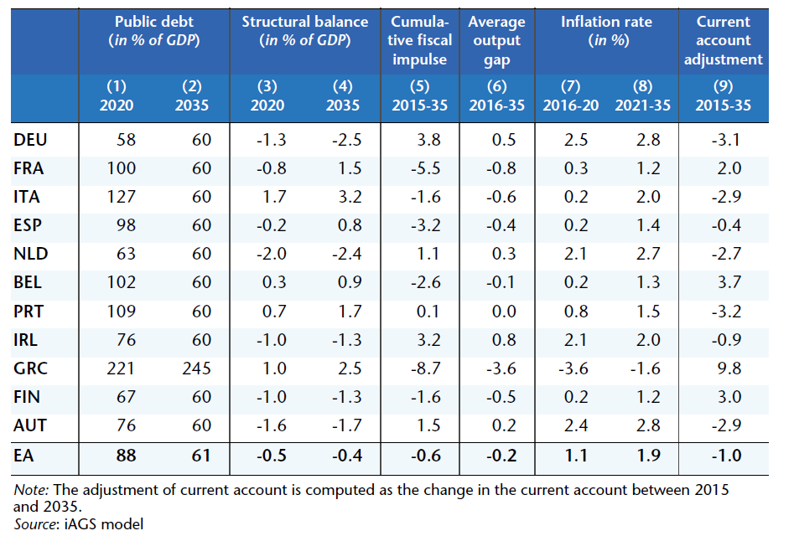
Dealing with external imbalances, how much adjustment of relative prices do we need ?

Slide 23
Evolution of unit labor costs compared to the average of the euro area
Index 1 = 1999, compared with the average of the euro area
Source : European Commission

Slide 24
Inflation rate : Germany should have more inflation
In %
Source : Eurostat

Slide 25
What are the optimal conditions to implement structural reforms?

Slide 26
Return on established and widespread views about the reasons of french unemployment
the unemployment benefit system : is it too generous ?
Scarpetta (1996), Nickell (1998), Elmeskov et alli (1998), Nunziata (2002), Bassanini et Duval (2006)

Slide 27
Net replacement rate of unemployed receiving benefits Unemployment benefits and other state transfers
Net replacement rate, in %
Gross replacement rate from unemployment insurance
Total net replacement rate including state transfers
If you include the state transfers, the French system is not more generous with the unemployed than elsewhere in others developped countries
Sources : OCDE, Coquet calculations

Slide 28
Return on established and widespread views about the reasons of french unemployment
the unemployment benefit system : is it too generous ?
Scarpetta (1996), Nickell (1998), Elmeskov et alli (1998), Nunziata (2002), Bassanini et Duval (2006)
the employment protection legislation : is it too strict ?
Bentolila et Bertola (1990)

Slide 29
Strictness of employment protection legislation : regular employment
Concerning legislation on employment, according to the OECD indicators, French law would be less protective than the German for permanent jobs.
Source : OECD

Slide 30
Strictness of employment protection legislation : temporary employment
Temporary jobs are less protected in Germany than in France.
Source : OECD

Slide 31
Return on established and widespread views about the reasons of french unemployment
the unemployment benefit system : is it too generous ?
Scarpetta (1996), Nickell (1998), Elmeskov et alli (1998), Nunziata (2002), Bassanini et Duval (2006)
the employment protection legislation : is it too strict ?
Bentolila et Bertola (1990)
the working time : is it too weak ?
Brechling (1965), Heyer et Timbeau (2000), Chemin and Wasmer (2009), Heyer (2011)

Slide 32
Annual hours worked per employee, total economy, 2014
In 2014, working time in France is not very high compares with the others developed countries.
But it is higher than in Germany or the Netherlands and the Scandinavian countries.
Source : OECD

Slide 33
Change in working hours since 1995 : All developed countries have reduced their working hours
In %, Annual hours worked per employee, total economy
All developed countries have reduced their working time in 20 years (with the exception of Denmark). This reduction was greater in Germany than in France, due to a stronger use of part-time work and especially a short-hour part-time work.
Source : OECD

Slide 34
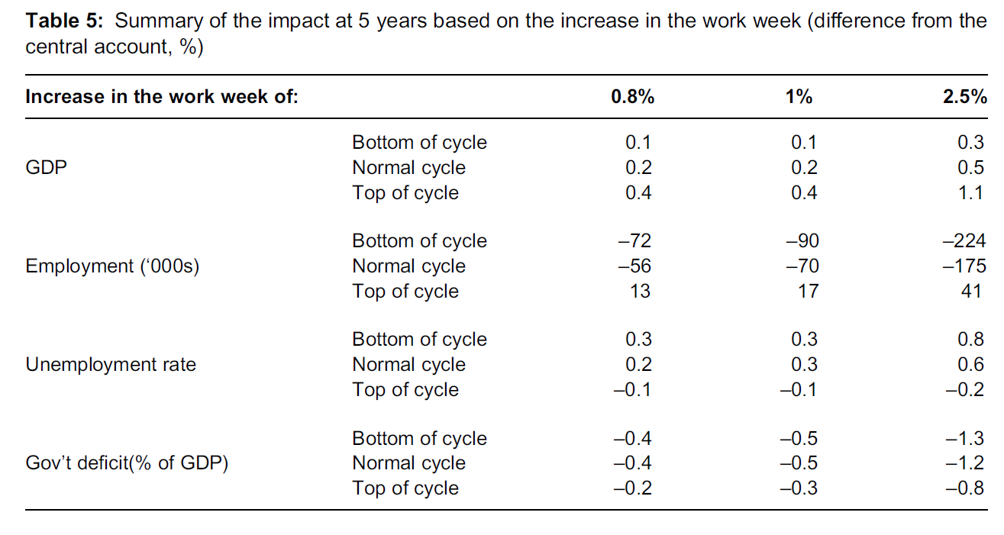
The impact of change in working time depends on the economy's position in the cycle when the measure is implemented
Source : Eric Heyer (2011), « The effectiveness of economic policy and position in the cycle : the case of taxe reductions on overtime in France », Oxford Review of Economic Policy, vol. 27, n° 2, summer.
When the economy is at the top of the cycle, increased working time is more appropriate than a decrease;
However, in a time of crisis, a reduction in working time is better for economic growth and for employment.

Slide 35
Return on established and widespread views about the reasons of french unemployment
the unemployment benefit system : is it too generous ?
Scarpetta (1996), Nickell (1998), Elmeskov et alli (1998), Nunziata (2002), Bassanini et Duval (2006)
the employment protection legislation : is it too strict ?
Bentolila et Bertola (1990)
the working time : is it too weak ?
Brechling (1965), Heyer et Timbeau (2000), Chemin and Wasmer (2009), Heyer (2011)
the youth unemployment rate : is it the highest ?

Slide 36
The youth unemployment : the ratio is more appropriate than the rate !
Youth unemployment rate
Youth unemployment ratio
In % of labour force, 15-24 years-olds
In % of total population, 15-24 years-olds
Source : OCDE
Note : The youth unemployment ratio is the share of unemployed youth in the total youth population
The difference is the denominator : in the rate is the labor force; the ratio is the total population.
Labour force is not representative of youth in France because two-thirds of French young people are outside the labor force.
When you are looking at the ratio, the proportion of young people unemployed in France is on the average European Union countries, even slightly lower than in the UK.

Slide 37
Return on established and widespread views about the reasons of french unemployment
the unemployment benefit system : is it too generous ?
Scarpetta (1996), Nickell (1998), Elmeskov et alli (1998), Nunziata (2002), Bassanini et Duval (2006)
the employment protection legislation : is it too strict ?
Bentolila et Bertola (1990)
the working time : is it too weak ?
Brechling (1965), Heyer et Timbeau (2000), Chemin and Wasmer (2009), Heyer (2011)
the youth unemployment rate : is it the highest ?
the minimum wage : is it too expensive ?
Card et Krueger (1995), Dolado et alii (1996), Elmeskov et alii (1998), Neumark et Washcer (1999)

Slide 38
Rate of employer contributions at the minimum wage : there are many exemptions
In % of gross salary
Recruitment subsides
When you take into account all the exemptions, it no longer exists any employer contributions at the minimum wage
French minimum wage employees are cheaper than the Polish plumber
Sources : Social security accounts, OFCE calculations

Slide 39
Public finances in Germany between 2002-2006 : we can not tighten all at once
En % du PIB
When the Germans introduced the Hartz reforms, they decided, at the same time, to let slip their public deficits and public debt beyond the Maastricht criteria
Sources : OCDE, OFCE calculations

Slide 40
Economic growth, Unemployment rate, poverty rate and external environment in Germany
In % In % of labour force / total population
Germany was the only one countries to implement this strategy of wage disinflation and in a context of strong global growth.
Despite the extremely favorable context, it should be noted that reforms have been slow to allow the return of growth and unemployment decline (about 4 years).
Sources : OCDE, OFCE calculations

Slide 41
Conclusion
The conditions today are not the same :
We lead this strategy all at once…
… in a context of weak global growth…
… and trying to reduce public deficits
It is likely that the results will not be as good as those of the germans

Slide 42
Annex

Slide 43
Variation of the labour force between 2008 and 2015
In %, annual average
Source : OECD

Slide 44
A hight level of the labour productivity (total economy)
Source : OECD

Slide 45
Underutilization of firms production capacity (French industry)
Source : INSEE

Slide 46
Industry production held back by ...
Source : INSEE

