Slide 1
Our European Problems
Xavier Ragot
OFCE and CNRS
xavier.ragot@sciencespo.fr

Slide 2
Triangle of our problems
Unemployment and growth in the short-run
- inequality
- European support
Nominal Divergences
- Nominal
- Real
Public debt
Banking problem (NPL)

Slide 3
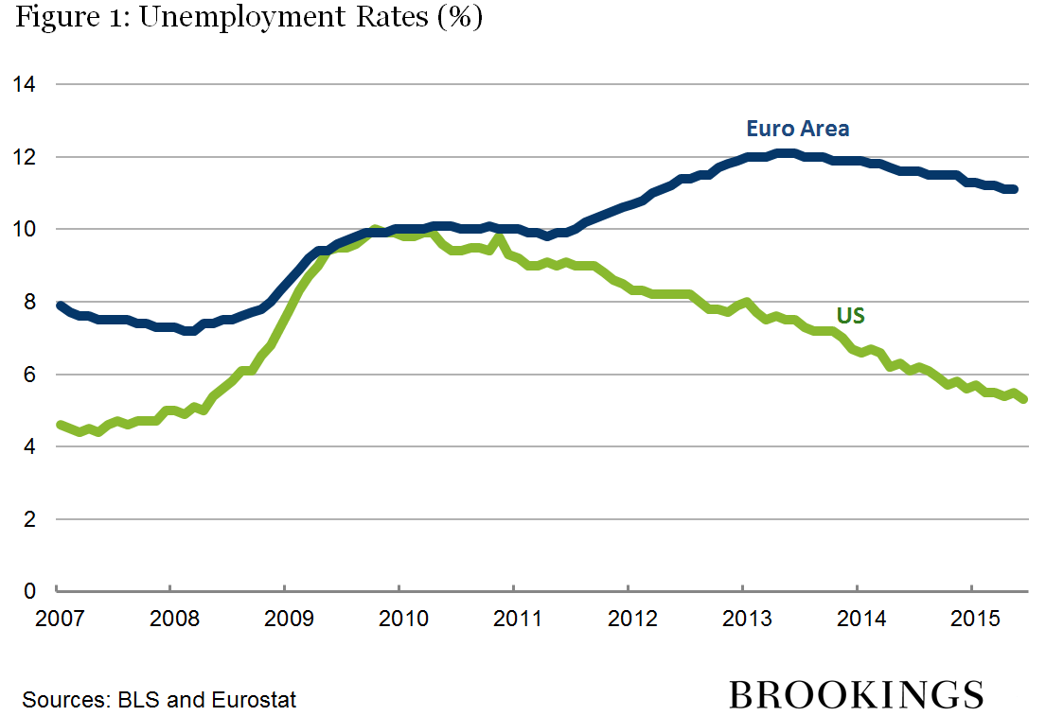
Demand management US/Euro area

Slide 4
The Demand Problem. Output gap en zone euro
Percentage of GDP
Source : OCDE

Slide 5
The Demand Problem. Inflation
En glissement annuel, en %
Source : Eurostat

Slide 6
Triangle of our problems
Unemployment and growth in the short-run
- inequality
- European support
Nominal Divergences
- Nominal
- Real
Public debt
Banking problem (NPL)

Slide 7
Supply TFP…

Slide 8
Supply : Weighted Unit Labor Cost
Source : Dustmann, Fitzenberger, Schönberg, et Spitz-Oener (2014)

Slide 9
Necessary adjustments… The internal devaluation
Horizon | 10 years | 20 years | 50 years | Infinite
Austria | +14.2% | +14.9% | +15.3% | +15.5%
Belgium | -16.9% | -16.1% | -15.6% | -15.3%
Finland | -15.5% | -14.3% | -13.7% | -13.3%
France | -4.3% | -4.5% | -4.7% | -4.7%
Germany | +21.8% | +21.8% | +21.8% | +21.8%
Greece | -43.7% | -13.7% | +4.3% | +14.8%
Ireland | -0.8% | +5.6% | +9.4% | +11.4%
Italy | +5.7% | +5.8% | +5.8% | +5.9%
Netherlands | +19.1% | +19.5% | +19.7% | +19.8%
Portugal | -17.4% | -3.2% | +5.3% | +10.1%
Spain | -5.4% | +2.9% | +7.9% | +10.6%
Source: iAGS, preliminary

Slide 10
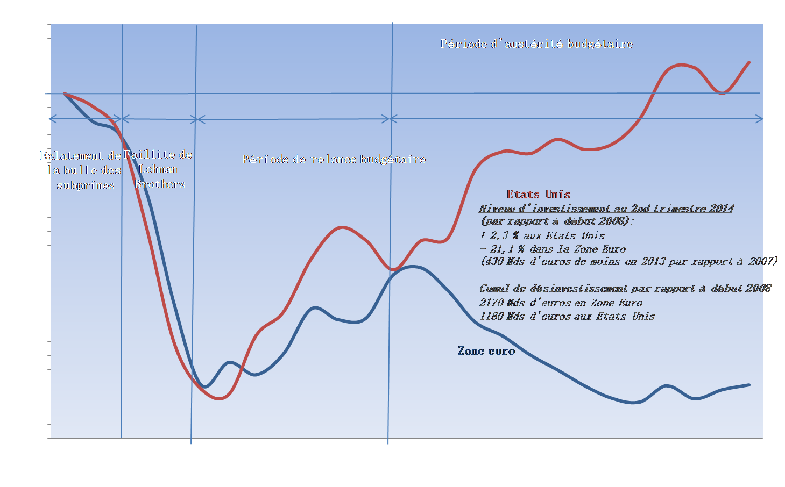
Supply : Investment in the US and Euro area (2008= 100)

Slide 11
Triangle of our problems
Unemployment and growth short-run
- inequality
- European support
Nominal Divergences
- Nominal
- Real
Public debt
restructr

Slide 12
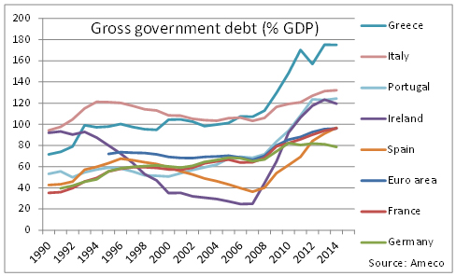

Slide 13
Triangle of our problems
Unemployment and growth short-run
- inequality
- European support
France
Geneva Group
Nominal Divergences
- Nominal
- Real
Public debt
Restructuring?
Germany

Slide 14
How to converge?
Key Questions :
  Frontier of the Euro : keep Greece in
  Commitment for a smooth fiscal consolidation : “trust”
  Managed transfers
Solution 1 : Wait and See
  Implement fiscal discipline
  Let political forces reshape Europe and Euro zone
Solution 2 : Debt at the European level:
  European unemployment insurance (1 or 2% of GDP) (Benassy-Quere and Ragot, CAE 2015)
  Public investment
    Nominal convergence : controlled price and wage dynamics
    Debt convergence (slow)
  Paliament for the Euro area : legislative power
  Change in the European semester for coordination (Benassy-Quere and Ragot, CAE 2015)

