Slide 1
Policy options at the zero lower bound
Session 5: How to implement stabilization policies with high public debt?
Timo Wollmershäuser & Atanas Hristov
Ifo Institute

Slide 2
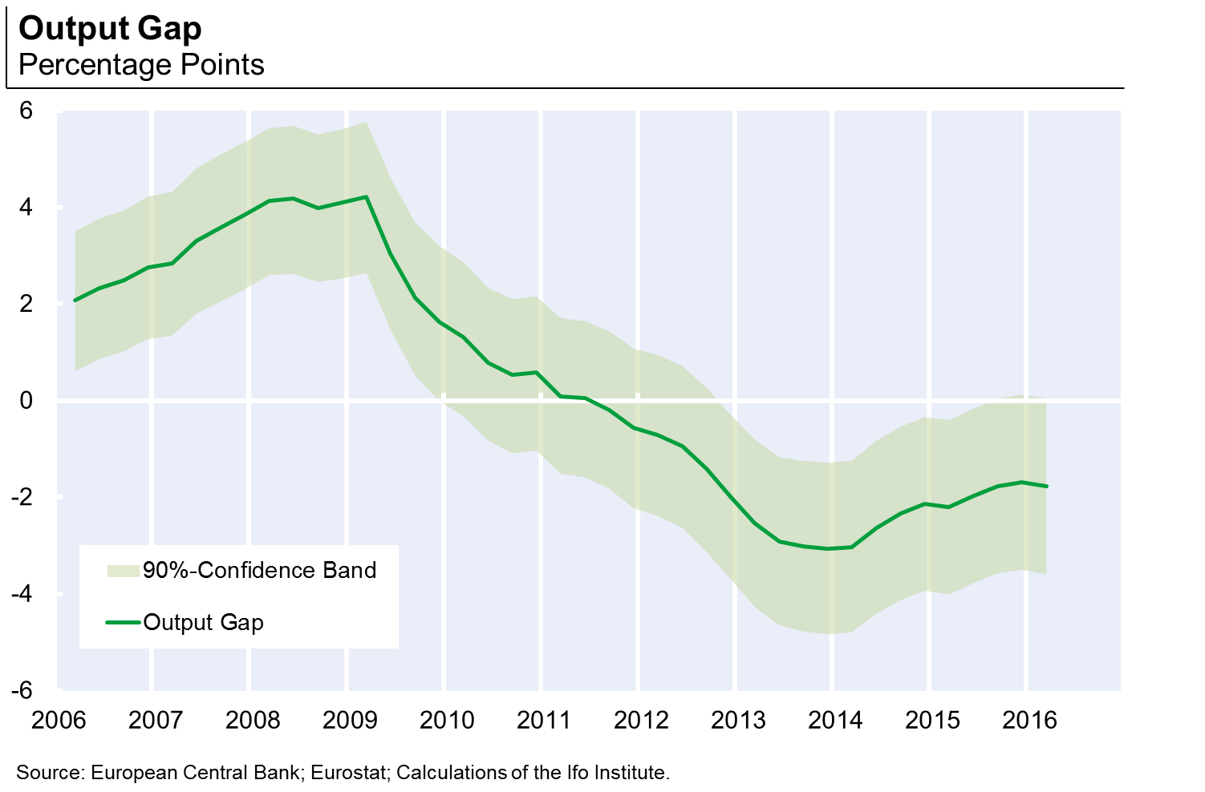
Introduction
very weak recovery from the crisis: negative output gap

Slide 3
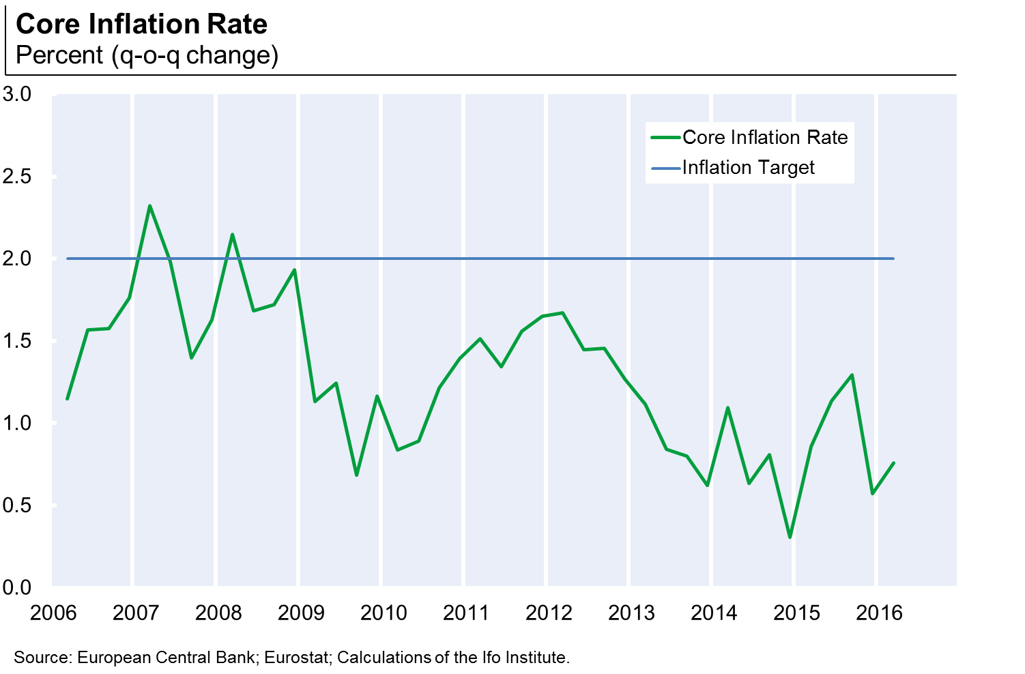
Introduction
very weak recovery from the crisis: inflation well below target

Slide 4
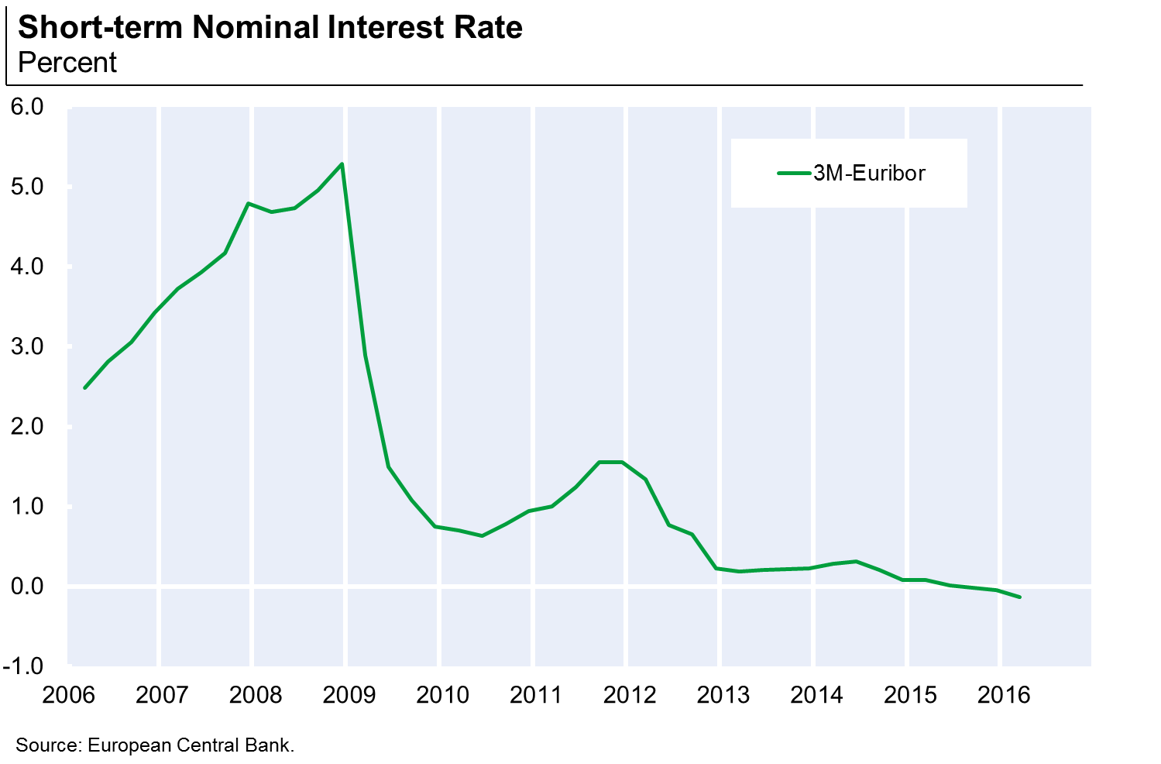
Introduction
very weak recovery from the crisis: interest rates at the ZLB

Slide 5
Introduction
very weak recovery from the crisis: interest rates at the ZLB
however, the stimulus from zero interest rates does not seem to be sufficient
  persistently negative output gap
  inflation below target since 2009
one explanation is that the interest rate that would be required in this situation is even lower than the actual interest rate
  natural real interest rate is below the actual real interest rate
this presentation
  estimates for the natural real interest rate for the euro area
  reasons for the low (negative) level
  discuss policy options at the ZLB with natural real interest rate is below the actual real interest rate

Slide 6
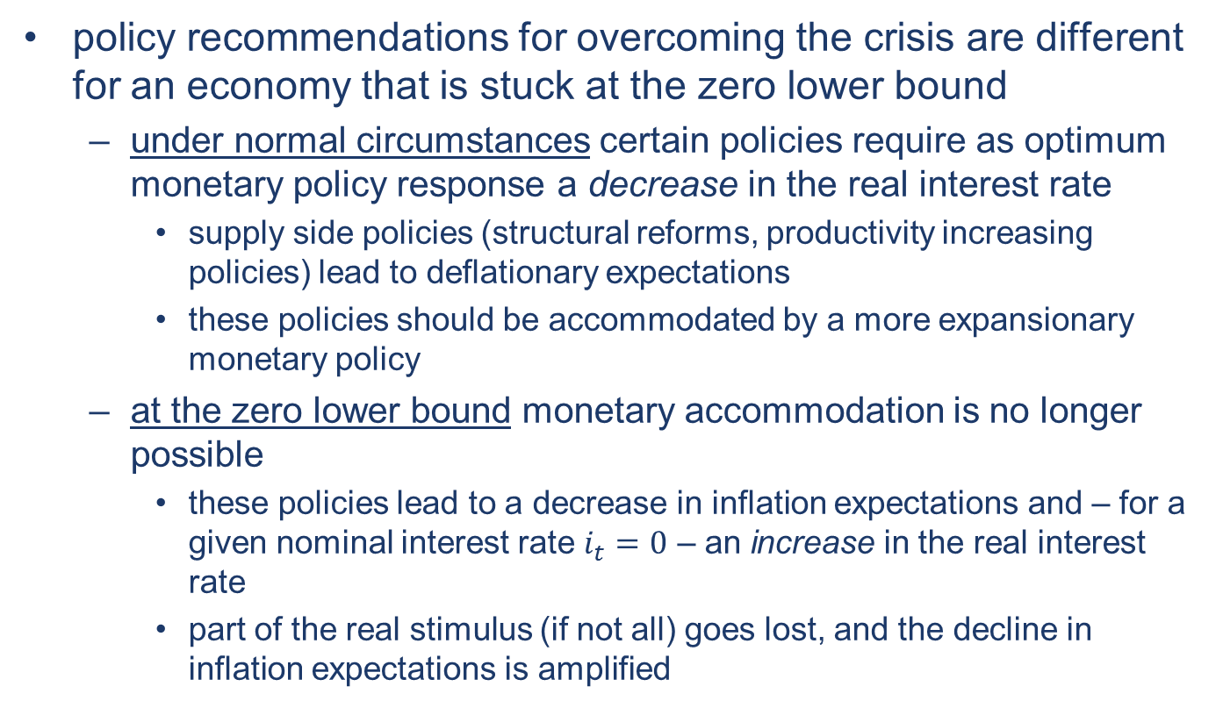
Introduction
policy recommendations for overcoming the crisis are different for an economy that is stuck at the zero lower bound
  under normal circumstances certain policies require as optimum monetary policy response a decrease in the real interest rate
    supply side policies (structural reforms, productivity increasing policies) lead to deflationary expectations
    these policies should be accommodated by a more expansionary monetary policy
  at the zero lower bound monetary accommodation is no longer possible
    these policies lead to a decrease in inflation expectations and – for a given nominal interest rate $i_{t}=0$ – an increase in the real interest rate
    part of the real stimulus (if not all) goes lost, and the decline in inflation expectations is amplified

Slide 7
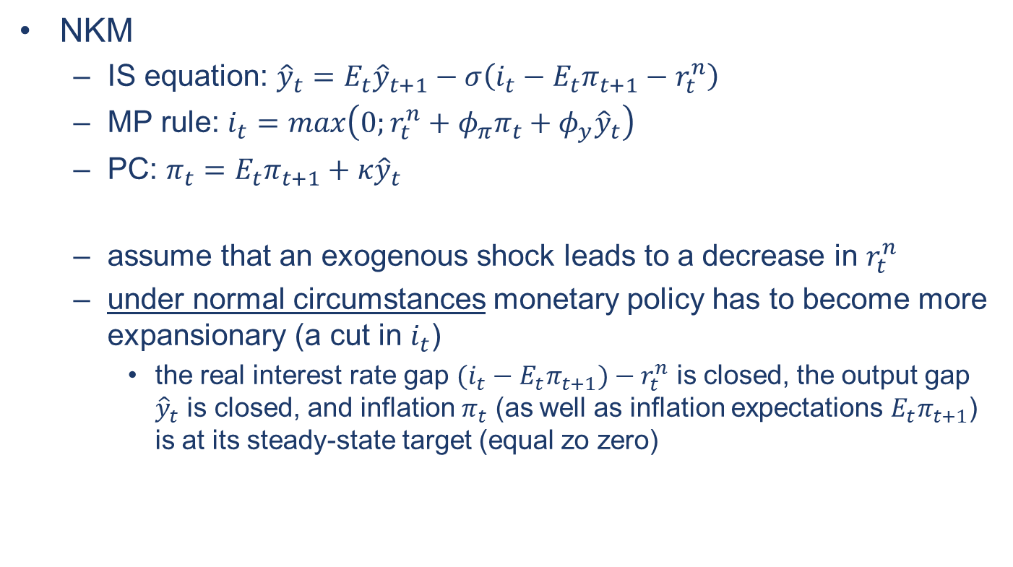
Concept of the natural real interest rate
NKM
  IS equation: ${\hat{y}}_{t}=E_{t}{\hat{y}}_{t+1}−σ\left(i_{t}−E_{t}π_{t+1}−r_{t}^{n}\right)$
  MP rule: $i_{t}=max\left(0;r_{t}^{n}+φ_{π}π_{t}+φ_{y}{\hat{y}}_{t}\right)$
  PC: $π_{t}=E_{t}π_{t+1}+κ{\hat{y}}_{t}$
  assume that an exogenous shock leads to a decrease in $r_{t}^{n}$
  under normal circumstances monetary policy has to become more expansionary (a cut in $i_{t}$)
    the real interest rate gap $(i_{t}−E_{t}π_{t+1})−r_{t}^{n}$ is closed, the output gap ${\hat{y}}_{t}$ is closed, and inflation $π_{t}$ (as well as inflation expectations $E_{t}π_{t+1}$) is at its steady-state target (equal zo zero)

Slide 8
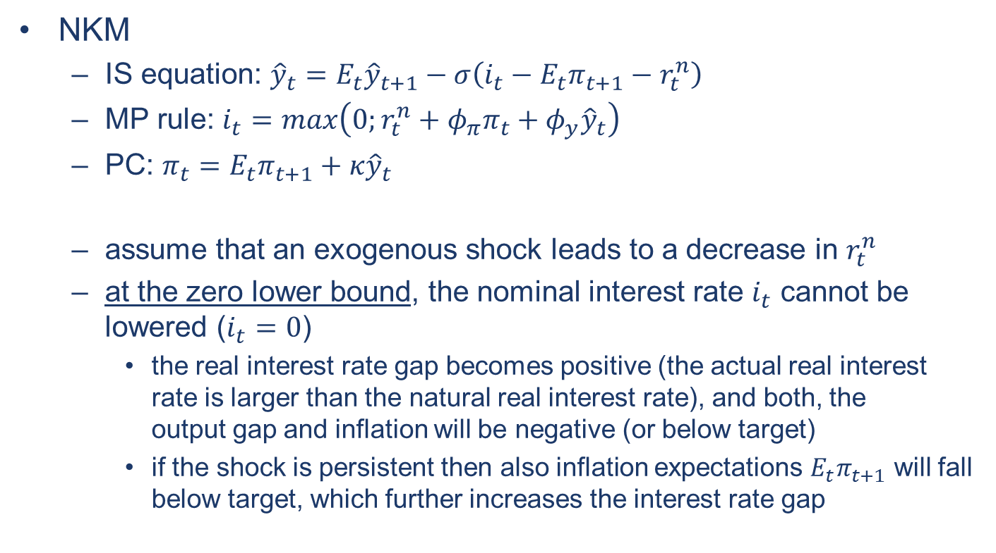
Concept of the natural real interest rate
NKM
  IS equation: ${\hat{y}}_{t}=E_{t}{\hat{y}}_{t+1}−σ\left(i_{t}−E_{t}π_{t+1}−r_{t}^{n}\right)$
  MP rule: $i_{t}=max\left(0;r_{t}^{n}+φ_{π}π_{t}+φ_{y}{\hat{y}}_{t}\right)$
  PC: $π_{t}=E_{t}π_{t+1}+κ{\hat{y}}_{t}$
  assume that an exogenous shock leads to a decrease in $r_{t}^{n}$
  at the zero lower bound, the nominal interest rate $i_{t}$ cannot be lowered ($i_{t}=0$)
    the real interest rate gap becomes positive (the actual real interest rate is larger than the natural real interest rate), and both, the output gap and inflation will be negative (or below target)
    if the shock is persistent then also inflation expectations $E_{t}π_{t+1}$ will fall below target, which further increases the interest rate gap

Slide 9
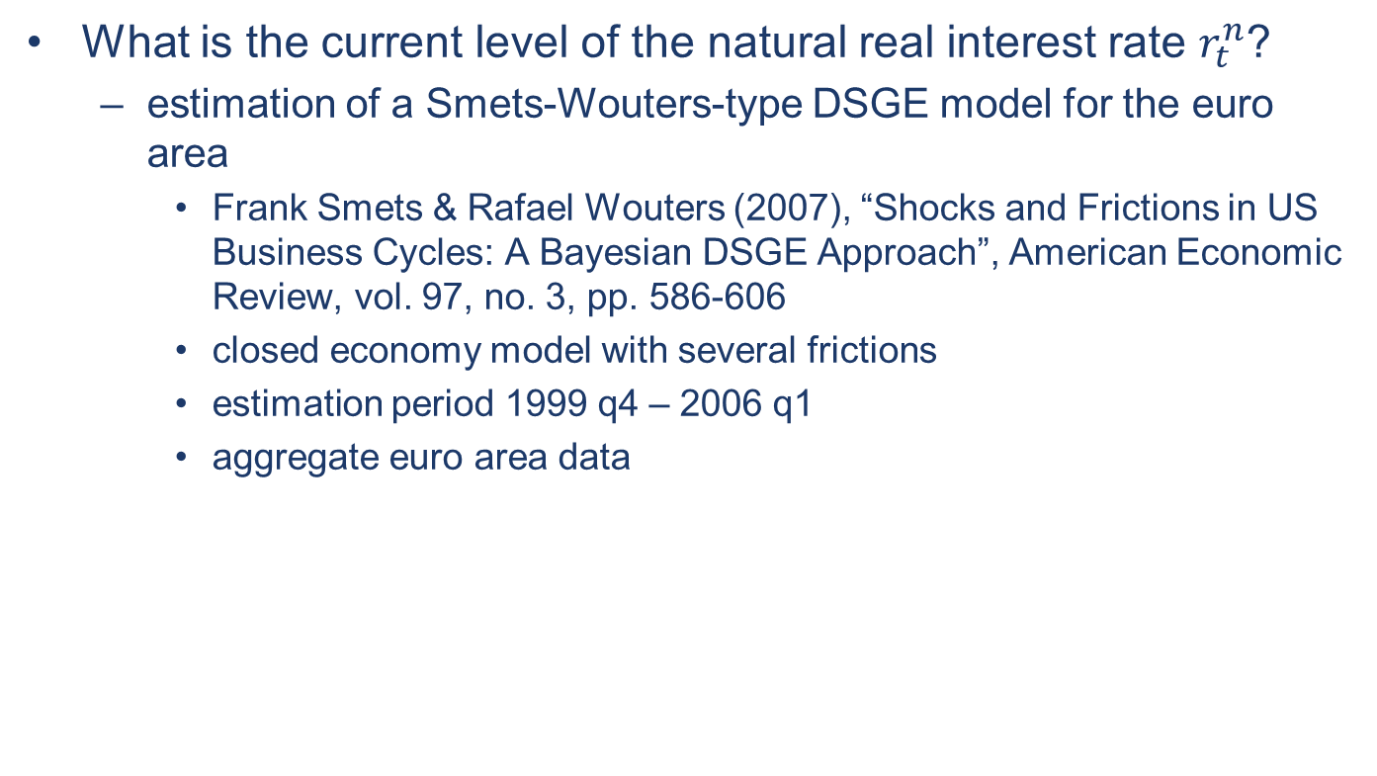
Evidence for the euro area
What is the current level of the natural real interest rate $r_{t}^{n}$?
  estimation of a Smets-Wouters-type DSGE model for the euro area
    Frank Smets & Rafael Wouters (2007), “Shocks and Frictions in US Business Cycles: A Bayesian DSGE Approach”, American Economic Review, vol. 97, no. 3, pp. 586-606
    closed economy model with several frictions
    estimation period 1999 q4 – 2006 q1
    aggregate euro area data

Slide 10
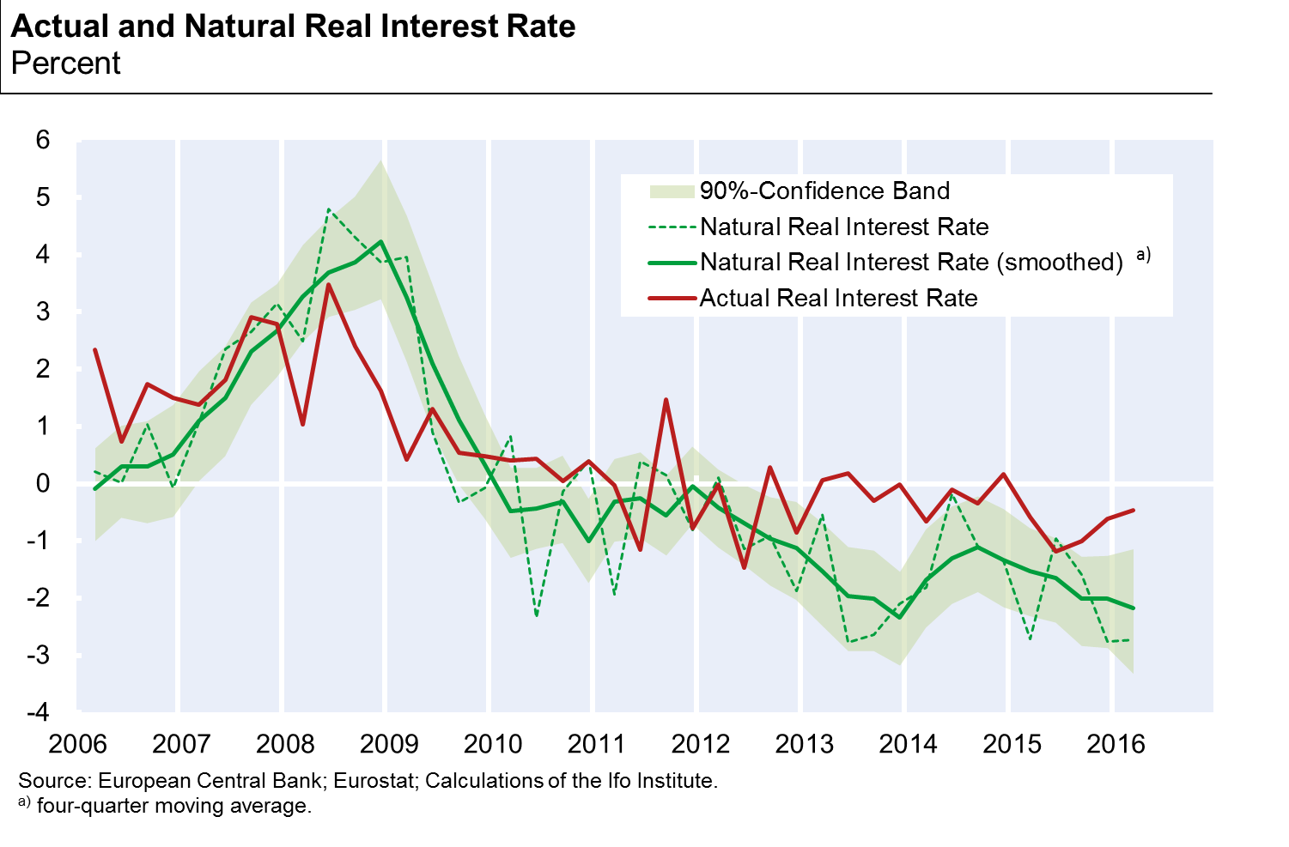

Evidence for the euro area
$r_{t}^{n}$negative / interest rate gap $\left(i_{t}−E_{t}π_{t+1}−r_{t}^{n}\right)$ positive

Slide 11
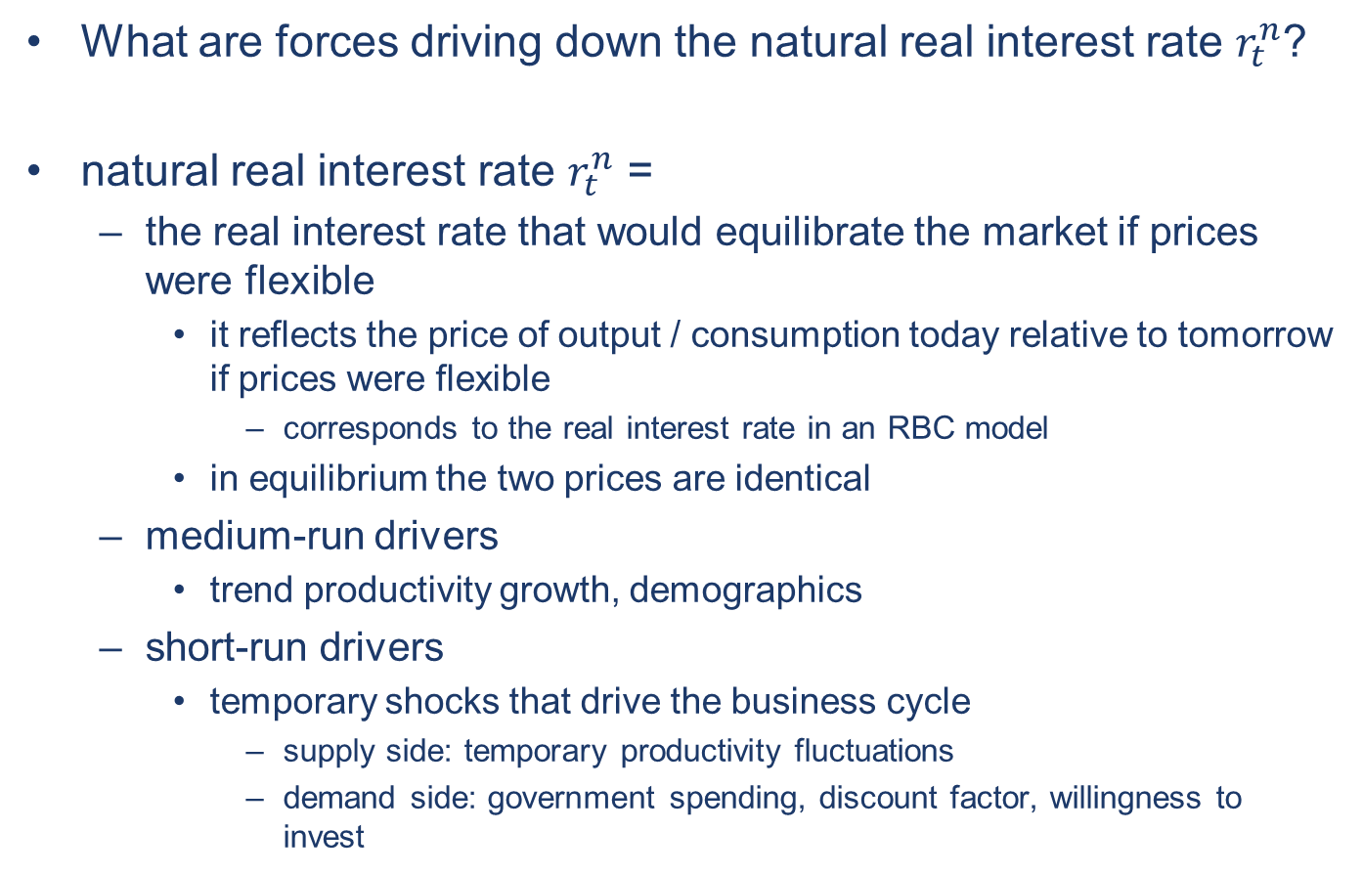
Concept of the natural real interest rate
What are forces driving down the natural real interest rate $r_{t}^{n}$?
natural real interest rate $r_{t}^{n}$ =
  the real interest rate that would equilibrate the market if prices were flexible
    it reflects the price of output / consumption today relative to tomorrow if prices were flexible
      corresponds to the real interest rate in an RBC model
    in equilibrium the two prices are identical
  medium-run drivers
    trend productivity growth, demographics
  short-run drivers
    temporary shocks that drive the business cycle
      supply side: temporary productivity fluctuations
      demand side: government spending, discount factor, willingness to invest

Slide 12
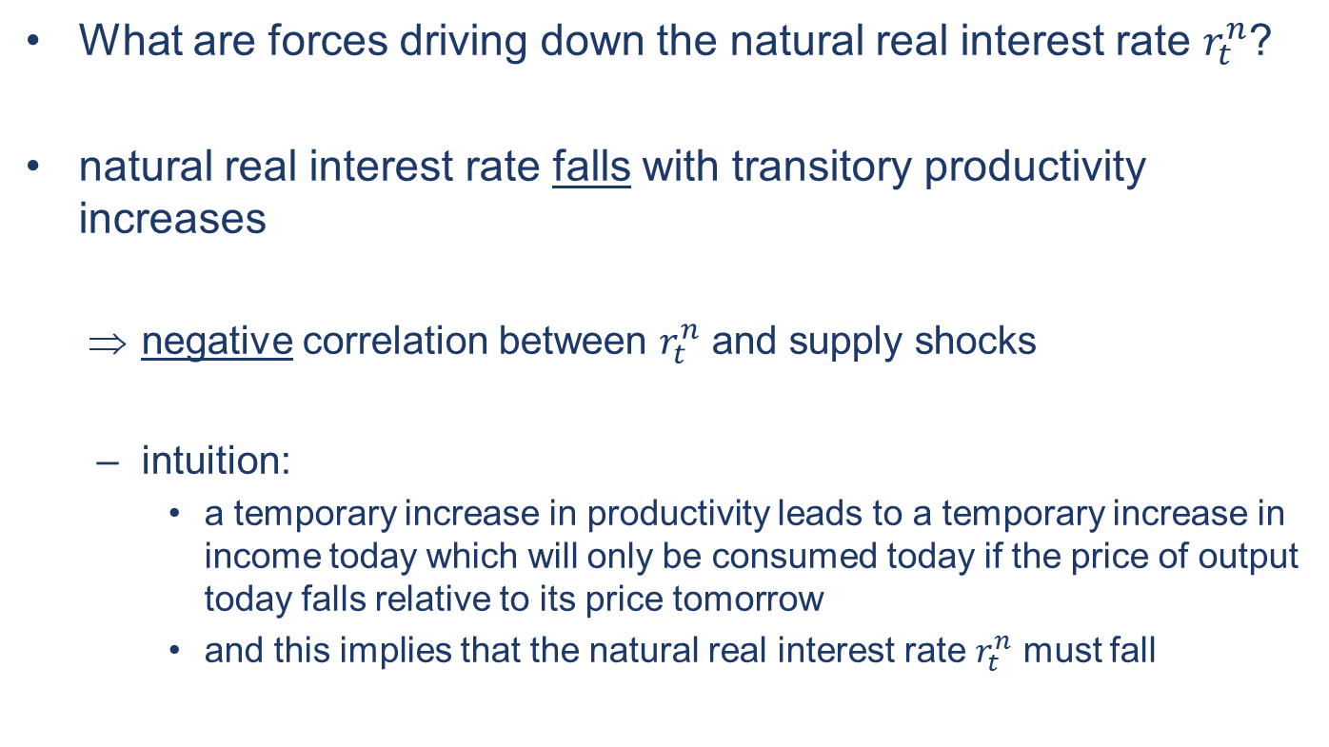
Concept of the natural real interest rate
What are forces driving down the natural real interest rate $r_{t}^{n}$?
natural real interest rate falls with transitory productivity increases
    negative correlation between $r_{t}^{n}$ and supply shocks
  intuition:
    a temporary increase in productivity leads to a temporary increase in income today which will only be consumed today if the price of output today falls relative to its price tomorrow
    and this implies that the natural real interest rate $r_{t}^{n}$ must fall

Slide 13
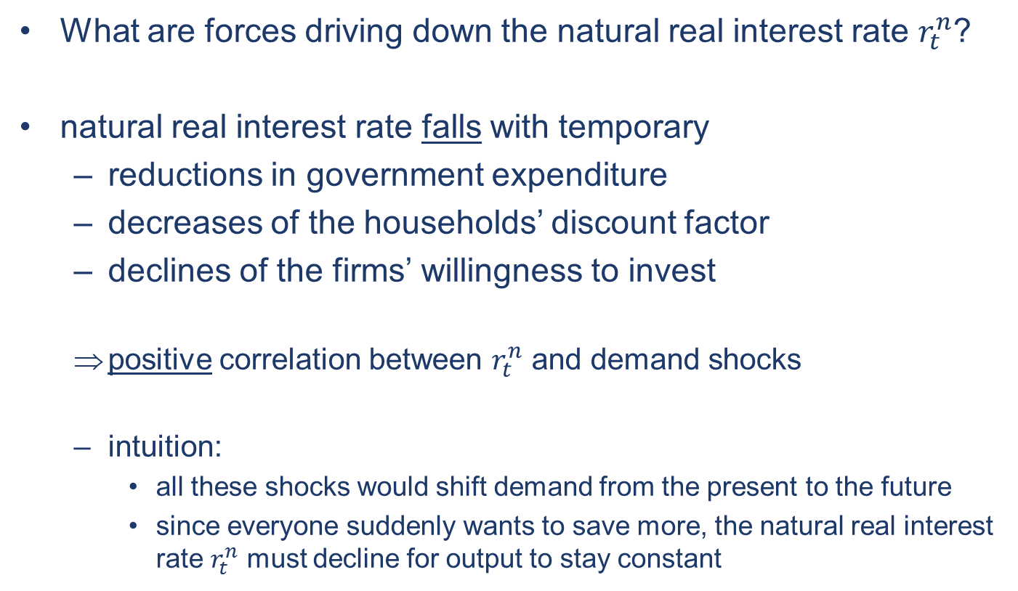
Concept of the natural real interest rate
What are forces driving down the natural real interest rate $r_{t}^{n}$?
natural real interest rate falls with temporary
  reductions in government expenditure
  decreases of the households’ discount factor
  declines of the firms’ willingness to invest
  positive correlation between $r_{t}^{n}$ and demand shocks
  intuition:
    all these shocks would shift demand from the present to the future
    since everyone suddenly wants to save more, the natural real interest rate $r_{t}^{n}$ must decline for output to stay constant

Slide 14
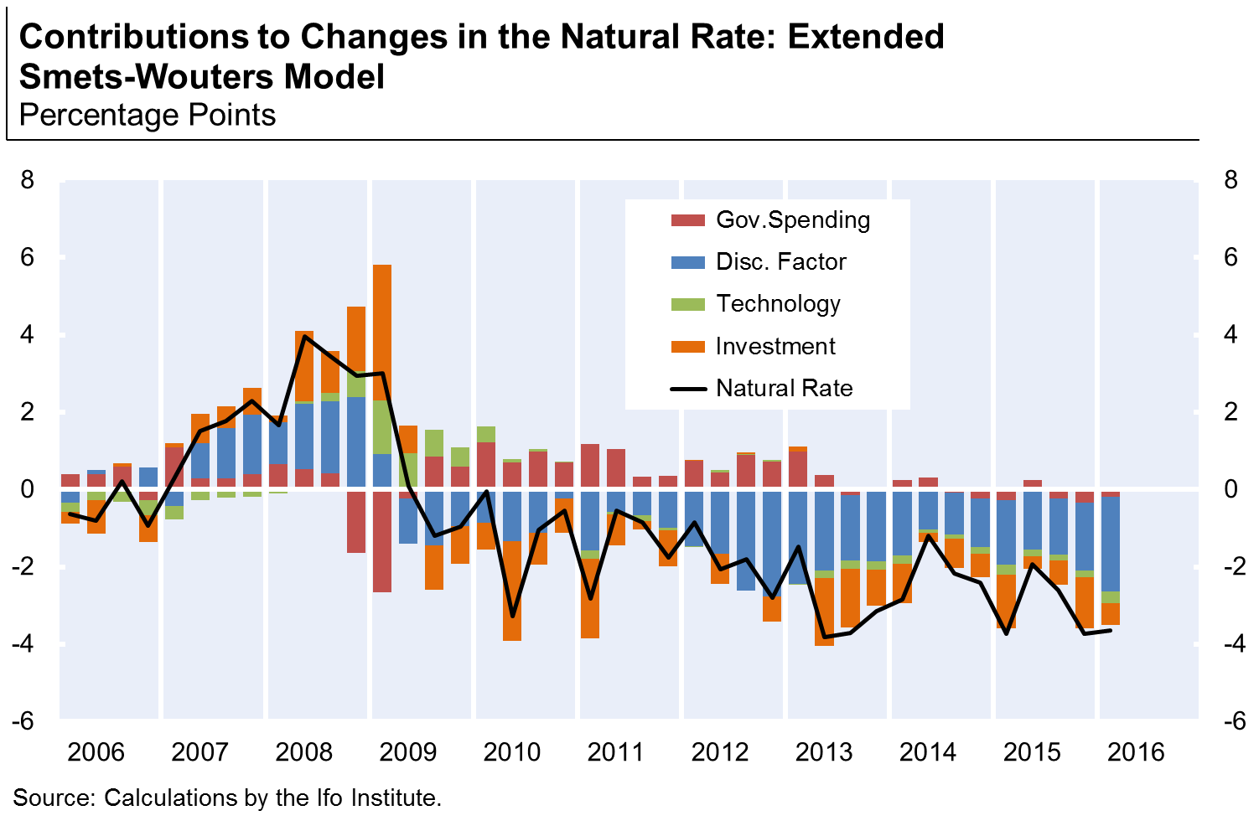

Evidence for the euro area
natural real interest rate ${\hat{r}}_{t}^{n}=r_{t}^{n}−{\overline{r}}^{n}$ negative (below ${\overline{r}}^{n}≈1\%$)

Slide 15

Evidence for the euro area
natural real interest rate $r_{t}^{n}$ negative
  sequence of negative discount factor shocks
  but currently also contractionary fiscal policy
  as well as productivity shocks (structural reforms)
  negative investment specific shocks

Slide 16
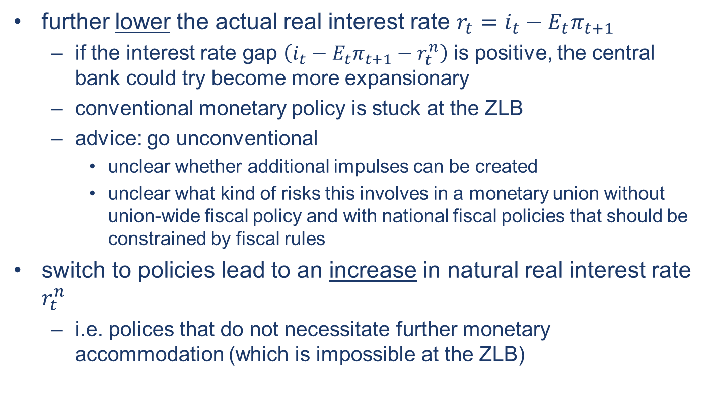
Policy implications
further lower the actual real interest rate $r_{t}=i_{t}−E_{t}π_{t+1}$
  if the interest rate gap $\left(i_{t}−E_{t}π_{t+1}−r_{t}^{n}\right)$ is positive, the central bank could try become more expansionary
  conventional monetary policy is stuck at the ZLB
  advice: go unconventional
    unclear whether additional impulses can be created
    unclear what kind of risks this involves in a monetary union without union-wide fiscal policy and with national fiscal policies that should be constrained by fiscal rules
switch to policies lead to an increase in natural real interest rate $r_{t}^{n}$
  i.e. polices that do not necessitate further monetary accommodation (which is impossible at the ZLB)

Slide 17
Policy implications
refrain from structural reforms in product and labour markets?
  not a good recommendation because of undoubtedly positive effects in the medium term
    in the model: structural reforms are often implemented as mark-up reductions which entail large negative price effects (e.g. deregulation by reducing anticompetitive barriers to firm entry)
  either clever choice of the polices (reforms with small short-term price effects)
    reduction of the labour tax wedge
    improvement labour market matching (active labour market policies)
    these polices mostly involve fiscal costs
      if no fiscal space, combine it with tax shifts to consumption
  or combine it with inflationary (e.g. expansionary fiscal) polices
    which compensate for the deflationary effects of structural reforms

Slide 18
Policy implications
raise government expenditure
  at the zero lower bound, fiscal expansion can be a powerful tool
    as it closes the gap between the actual real interest rate (for a given zero nominal interest rate) and the natural real interest rate
    by this increases the effectiveness of monetary policy
  major handicap of the euro zone:
    no fiscal policy at the euro-zone level
    fiscal space at the national level limited in many countries
      rules of the Fiscal Compact
    this is one of the features that makes the EA very different from the US

Slide 19
Policy implications

Slide 20
Policy implications

Slide 21
Policy implications

Slide 22
Policy implications
raise government expenditure
  at the zero lower bound, fiscal expansion can be a powerful tool
    as it closes the gap between the actual real interest rate (for a given zero nominal interest rate) and the natural real interest rate
    by this increases the effectiveness of monetary policy
  major handicap of the euro zone:
    no fiscal policy at the euro-zone level
    fiscal space at the national level limited in many countries
      rules of the Fiscal Compact
    this is one of the features that makes the EA very different from the US
    should we question the rules?
      rules that have never been observed in the past
      rules (& sanctions) that should replace discipline imposed by the market
      would the market sanction fiscal expansion at the ZLB

Slide 23
Policy implications
improve incentives to invest
  major obstacle for investment in many EA countries are financial constraints on the side of the firms
  non-performing loans (NPL) as a major source of frictions

Slide 24
Policy implications
Source: IMF Global Financial Stability Report April 2016

Slide 25
Policy implications
improve incentives to invest
  major obstacle for investment in many EA countries are financial constraints on the side of the firms
  non-performing loans (NPL) as a major source of frictions
    limits the banks’ ability to lend to the real economy
    lower profitability (due to higher provisioning needs), higher capital requirements (NPL are risky assets), higher funding costs (market lender demand risk premia)
  ways to reduce NPL
    transfer of distressed assets to (publicly owned) bad banks
    asset protection schemes to cover the losses related to a specific portfolio of assets
  in any case fiscal support for the banking system is required
    EAA and FMS in Germany since 2009
    NAMA in Ireland since 2009
    SAREB in Spain since 2012

Slide 26
Policy implications

Slide 27
Policy implications

Slide 28
Policy options at the zero lower bound
Session 5: How to implement stabilization policies with high public debt?
Timo Wollmershäuser & Atanas Hristov
Ifo Institute

Slide 29
Back-up slides

Slide 30
Smets-Wouters Model Overview
New Keynesian DSGE model
  continuum of households
    supply household-specific labor in monopolistic competition
    set wages, which are Calvo-sticky
    own the capital stock, which they rent to the intermediate good firms
    for given income higher investment today means lower consumption (budget constraint)
    habit formation, investment adjustment costs, variable capital utilization
  continuum of intermediate good firms
    supply intermediate goods in monopolistic competition using labor and capital input
    set prices, which are Calvo-sticky
  final goods use intermediate goods and are produced in perfect competition
  monetary authority follows a Taylor-type rule
  many sources of shocks - enough to make sure the data can be matched to the model

Slide 31
Smets-Wouters Model Overview
Modifications
  estimated with employment data, instead of aggregate hours worked
  replace the transitory technology shocks with permanent shocks in technology
    the permanent technology follows an AR(1) in growth rates in technology
  model extension by introducing credit frictions in the Smets-Wouters framework, using the financial accelerator mechanism proposed by Bernanke, Gertler and Gilchrist (1999)

Slide 32
Estimation Overview
estimated with Bayesian techniques using 7 (or 8) data series
  real variables
    private consumption
    GDP
    investment
    employment
  nominal variables
    core inflation
    wages per capita
    (spread between private non-financial lending rates and 10-year German government bond yield)
  Monetary policy
    3-month Euribor rate
all other (latent) model variables, including the models exogenous processes, are estimated as part of the Kalman-filter routine
estimation period 1999q4 to 2016q1

Slide 33

Concept of the natural real interest rate (NRIR)
NKM
  IS equation: ${\hat{y}}_{t}=E_{t}{\hat{y}}_{t+1}−σ\left(i_{t}−E_{t}π_{t+1}−r_{t}^{n}\right)$
  MP rule: $i_{t}=max\left(0;r_{t}^{n}+φ_{π}π_{t}+φ_{y}{\hat{y}}_{t}\right)$
  PC: $π_{t}=E_{t}π_{t+1}+κ{\hat{y}}_{t}$
⇒ AD curve
⇒ AS curve

Slide 34






Concept of the natural real interest rate (NRIR)
under normal circumstances
$$π$$
$$AS$$
$$π_{0}$$
$$AD$$
$$\hat{y}$$
$$\hat{y}=0$$

Slide 35

Concept of the natural real interest rate (NRIR)
at the zero lower bound
$$π$$
$$AD$$
$$AS$$
$$π_{0}$$
$$\hat{y}$$
$$\hat{y}=0$$

Slide 36
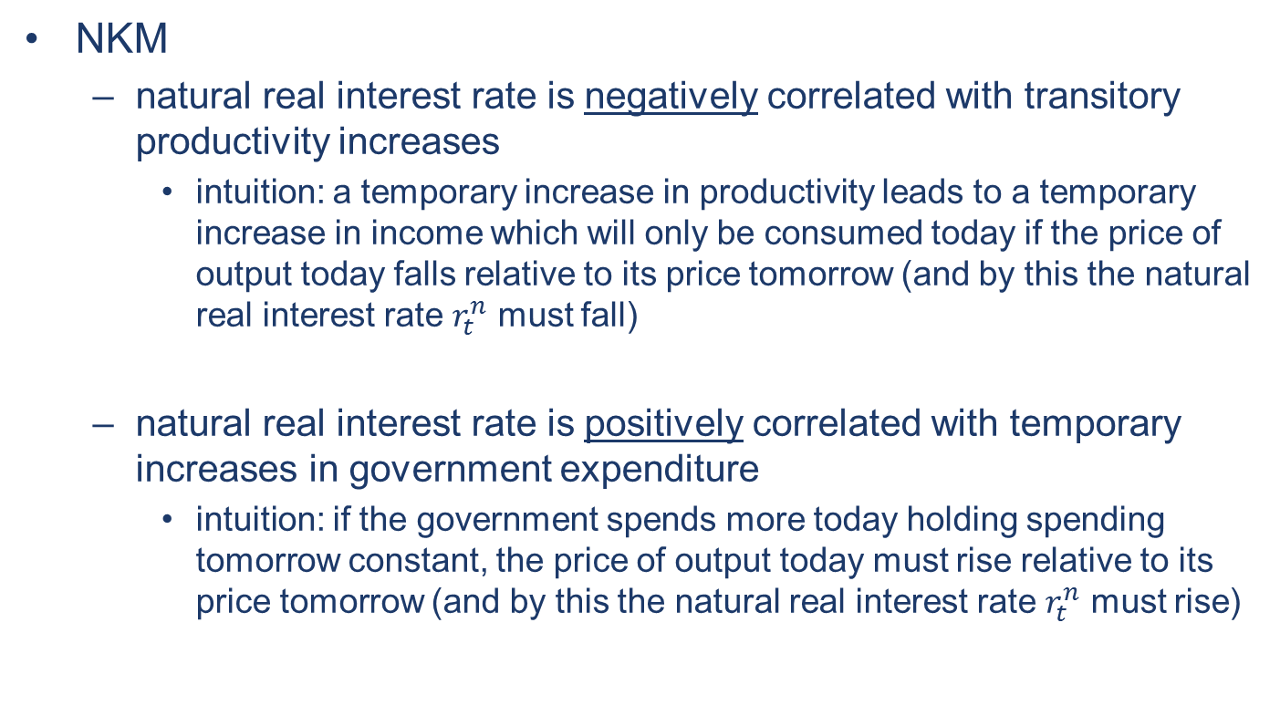
Concept of the natural real interest rate
NKM
  natural real interest rate is negatively correlated with transitory productivity increases
    intuition: a temporary increase in productivity leads to a temporary increase in income which will only be consumed today if the price of output today falls relative to its price tomorrow (and by this the natural real interest rate $r_{t}^{n}$ must fall)
  natural real interest rate is positively correlated with temporary increases in government expenditure
    intuition: if the government spends more today holding spending tomorrow constant, the price of output today must rise relative to its price tomorrow (and by this the natural real interest rate $r_{t}^{n}$ must rise)

Slide 37
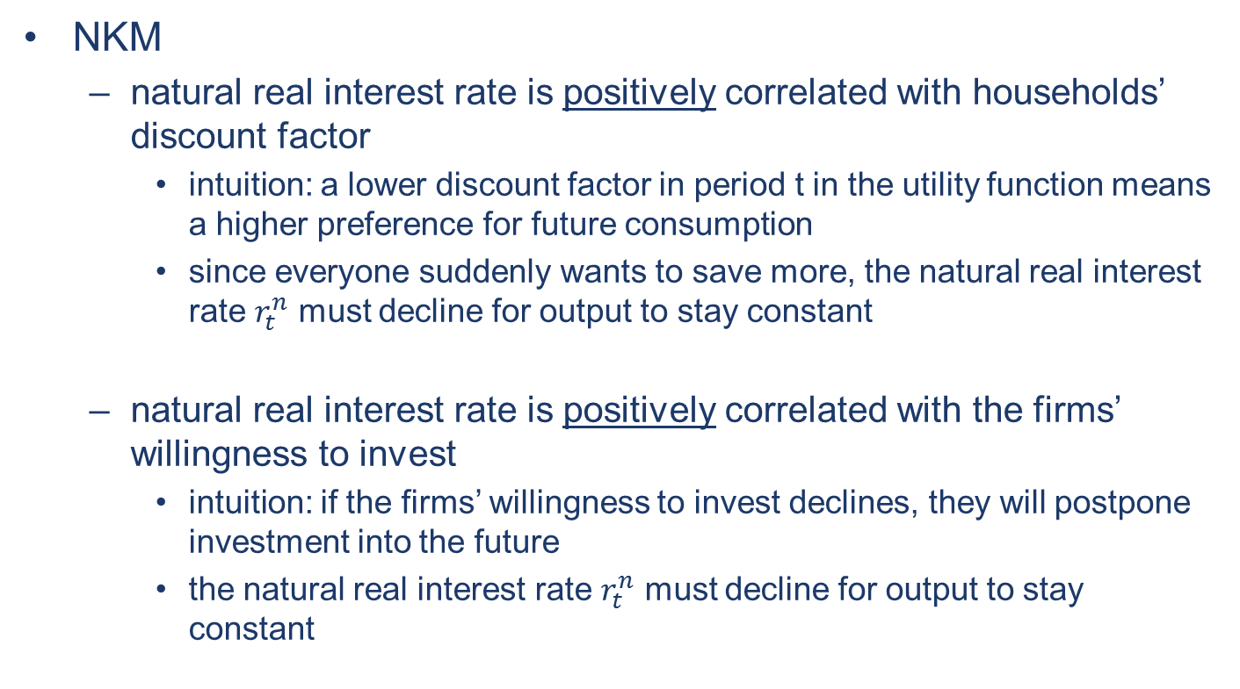
Concept of the natural real interest rate
NKM
  natural real interest rate is positively correlated with households’ discount factor
    intuition: a lower discount factor in period t in the utility function means a higher preference for future consumption
    since everyone suddenly wants to save more, the natural real interest rate $r_{t}^{n}$ must decline for output to stay constant
  natural real interest rate is positively correlated with the firms’ willingness to invest
    intuition: if the firms’ willingness to invest declines, they will postpone investment into the future
    the natural real interest rate $r_{t}^{n}$ must decline for output to stay constant

