Slide 1
Reforming the euro area:
Where do we stand
Jean Pisani-Ferry*
CEPII-CESifo-DIW-OFCE conference
Paris, 8 July 2016
* Hertie School, Berlin, and France Stratégie, Paris

Slide 2
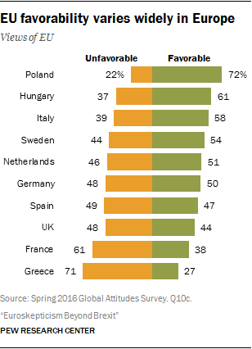
Time to get serious (again)
Brexit
Economic risk
Political risk
Market risk
On the agenda
Economic revival
Economics of currency union
Politics of monetary integration

Slide 3
What problems?
Infrastructure
Integration within European market
Economic resilience
Growth potential
Legacy
Debt
Banks
Real exchange rates
Unemployment
Policy principles
Supply / demand
Individual responsibility / risk sharing
Governance model

Slide 4
Where / why do we disagree?
Not fundamentally on infrastructure
Domestic agenda and EMU agenda largely coincide
Issues to be solved:
  Integration (pan-European banks; labour mobility)
  Reform commitment
A lot on legacy issues
Creditors vs. debtors
Skeletons in the cupboard
Question: can we find agreement on policy principles?
Cognitive dissonance (alternative crisis models)
Preference heterogeneity
Compatibility with domestic political systems
5P report: the wrong strategy
Rather: blueprint first, then address legacy issues

Slide 5
Supply / demand: an economists’ dispute
French and German economists argue at length over the appropriate fiscal stance
In reality:
  French fiscal policy not that stabilising (especially bad at consolidating in good times)
  German fiscal policy not that procyclical (especially good at consolidating in good times)
Implications:
Do not overestimate practical importance of differences in policy philosophy
Room for agreement on policy principles

Slide 6
Fiscal stabilisation in France, 1996-2015: 15/45

Slide 7
Fiscal stabilisation in Germany, 1996-2015: 30/55

Slide 8
Individual responsibility / risk sharing:
Room for (good) compromise
German view emphasises moral hazard, adverse effects of bail-outs
French view emphasises solidarity as a quid pro quo for discipline
Key in discussions on:
Fiscal regime
Banking union
Reforms
A balanced compromise:
Debt restructuring scheme based on ESM
Full banking union with deposit guarantee and fiscal backstop
Common safe asset
Fiscal discipline rules

Slide 9
Governance model:
Room for triangulation
French view emphasises discretion and coordination
German view emphasises rules and competence delineation
Both often inconsistent:
F reluctant to rules-based coordination
G reluctant to delegation to EZ level
Result: messy, ineffective and illegitimate governance
In reality three possible models:
Full decentralisation and market discipline (à la Ashok Mody)
Common targets + coordination (e.g. Villeroy’s MOF)
Federalisation and common institutions (EZ budget)
Problem: hard to compromise between (a) and (b) but F and G reluctant to (c)
Room for clever triangulation?
Hub and spoke model for national fiscal policies: strong common institutions, strong national institutions (fiscal councils, productivity councils)
Limited fiscal capacity at EZ level for spending on common public goods and contingent aggregate stabilisation

Slide 10
Thoughts on legacy issues
Significant efforts to address legacy issues without fiscal transfers (see e.g. recent CEPR report)
Useful attempts but do not design the permanent regime with a view on addressing legacy problems
Better pay one-off price for legacy than accept permanent design flaw

